Slide 1


Deep CNN-LSTM Supervised model and CNN Self-supervised model for Human Activity Recognition
PSCSE21-0033
Student: Liao Zixin
Supervisor: Kwoh Chee Keong
May 2023

Slide 2
Agenda
Part I
Part II
Introduction
Previous work
Network architecture
Dataset
Experiment
Future work
Q&A
liao0080@e.ntu.edu.sg

Slide 3
Introduction
A CNN-LSTM-Attention supervised network
A 1-D CNN self-supervised(SSL) network
Network
Dataset
3 public HAR datasets: UCIHAR, HHAR, HAPT*
Performance
5% of labeled fine-tuning, SSL better than supervised learning
Robustness of SSL in label scarcity problem
Effectiveness of the smart sensor
liao0080@e.ntu.edu.sg

Slide 4
Previous work
Supervised network(HAR):
Kwapisz(2010): ML | Acc 85%
Esfahani & Malazi(2017): CNN | Acc 88.5%
Preeti & Mansaf(2020): RNN-LSTM | Acc 95.78%
Mutegeki & Han(2020): LSTM-CNN | Acc 94%
SSL network:
Sarkar & Etemad (2020): ECG dataset | Acc 99.2%
Eldele(2023): Sleep stage dataset | Acc 90.37%
Zhang (2021): HAR dataset | Acc 95.78%
liao0080@e.ntu.edu.sg

Slide 5
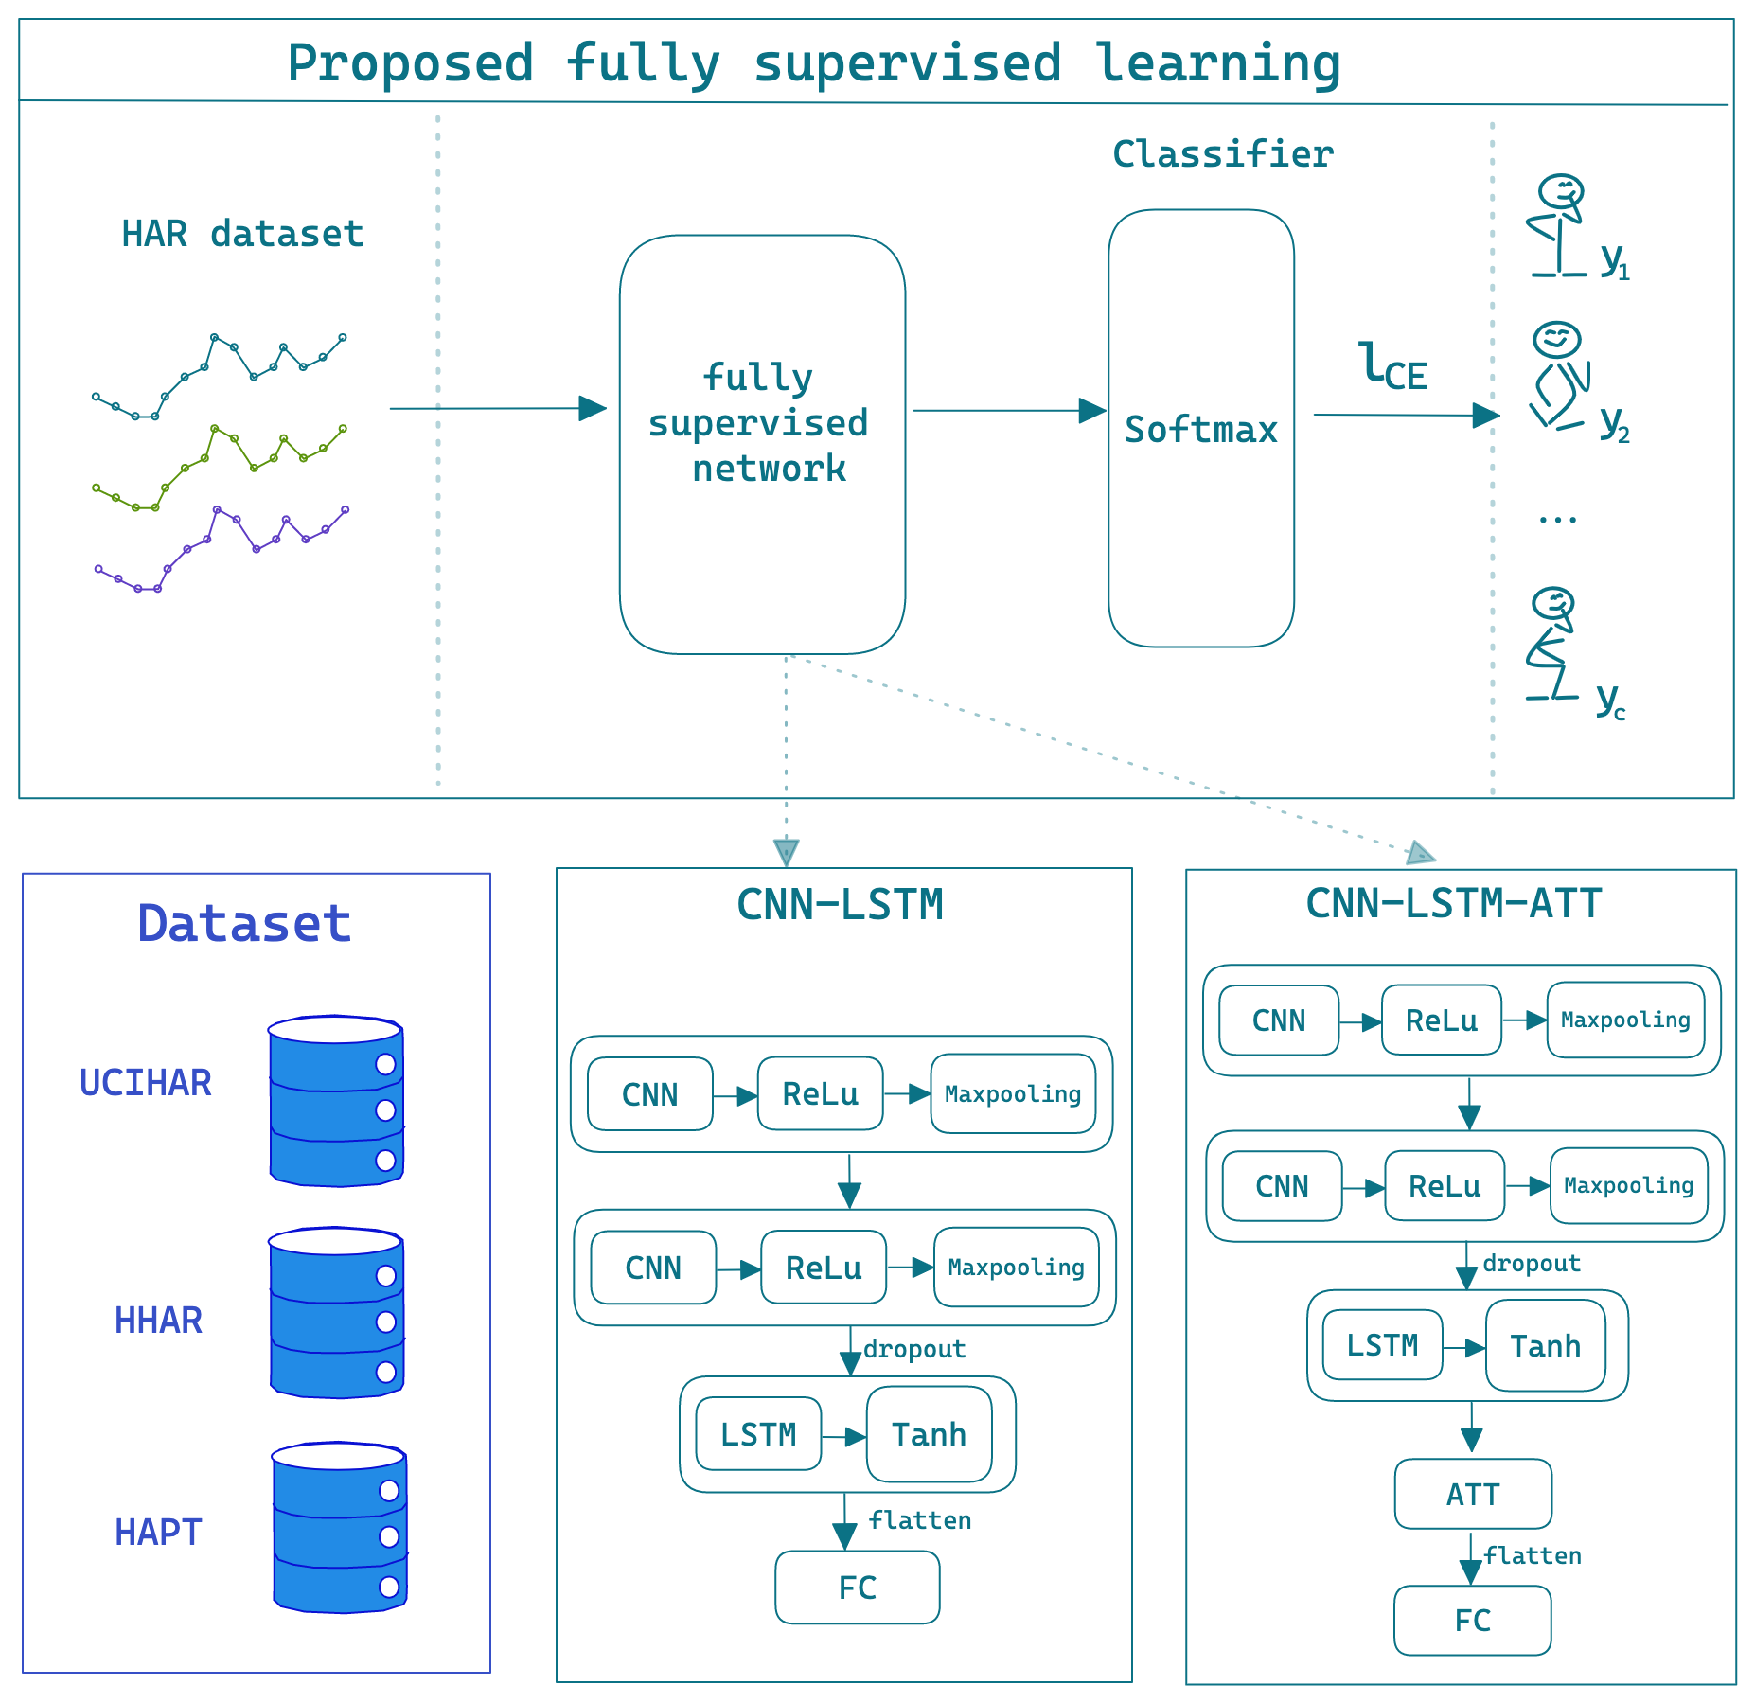
Supervised CNN-LSTM-ATT Model
liao0080@e.ntu.edu.sg

Slide 6
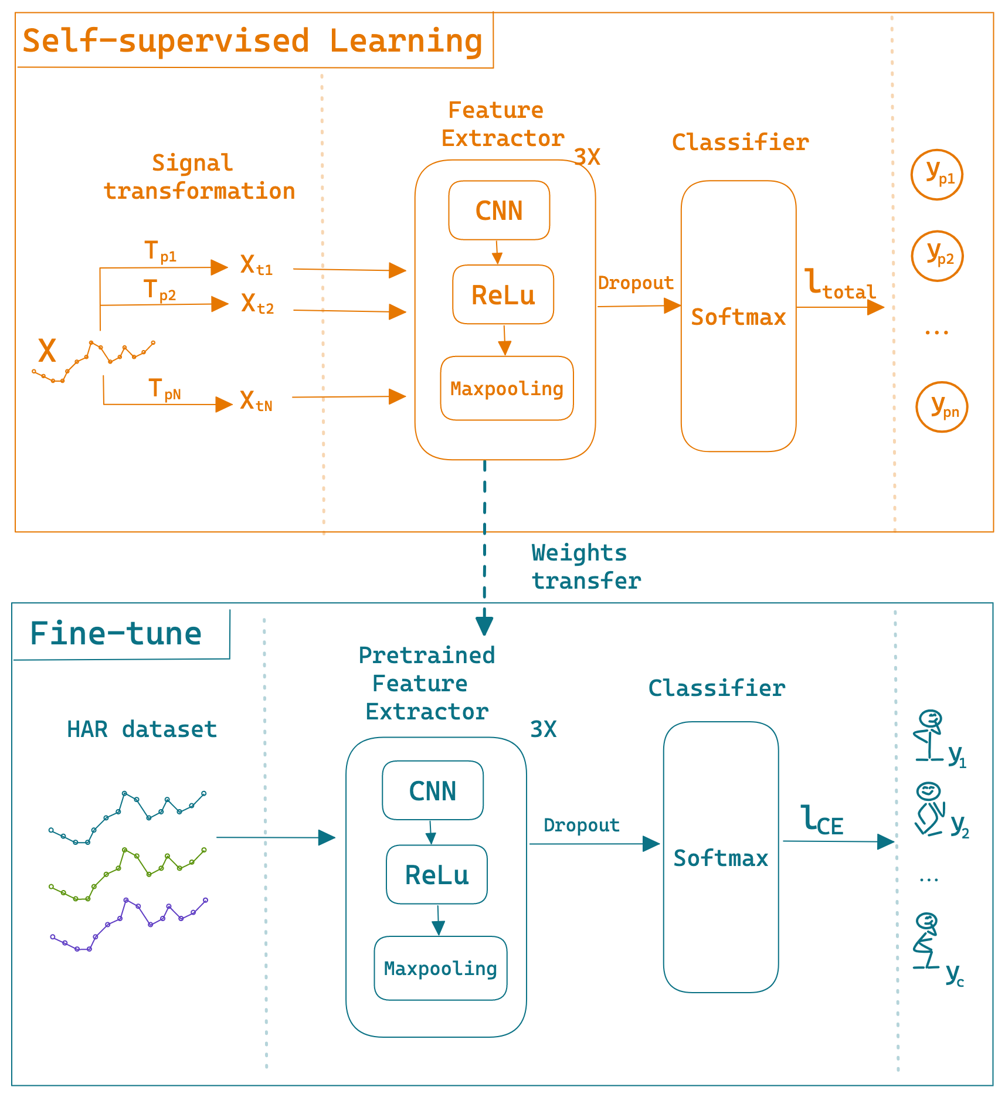
1D-CNN Self-supervised Model
Stage 1: Pretext Task
Permutation
Time shift
Scaling
Adding noise
Model robustness:
data augmentation techniques
onsistency loss: MSE loss for X ori and X trans;
Cross-entropy loss.
4
C
Stage 2: Learn to classify activity
Fine-tuning with limited data labels
liao0080@e.ntu.edu.sg

Slide 7
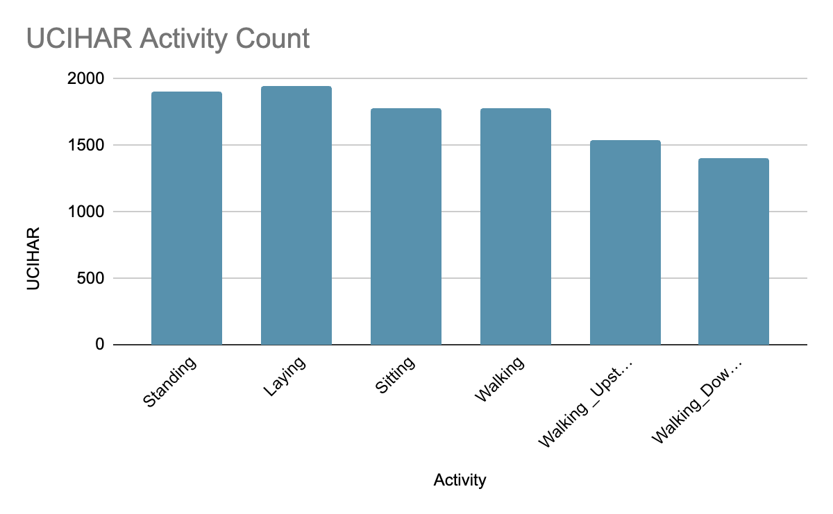
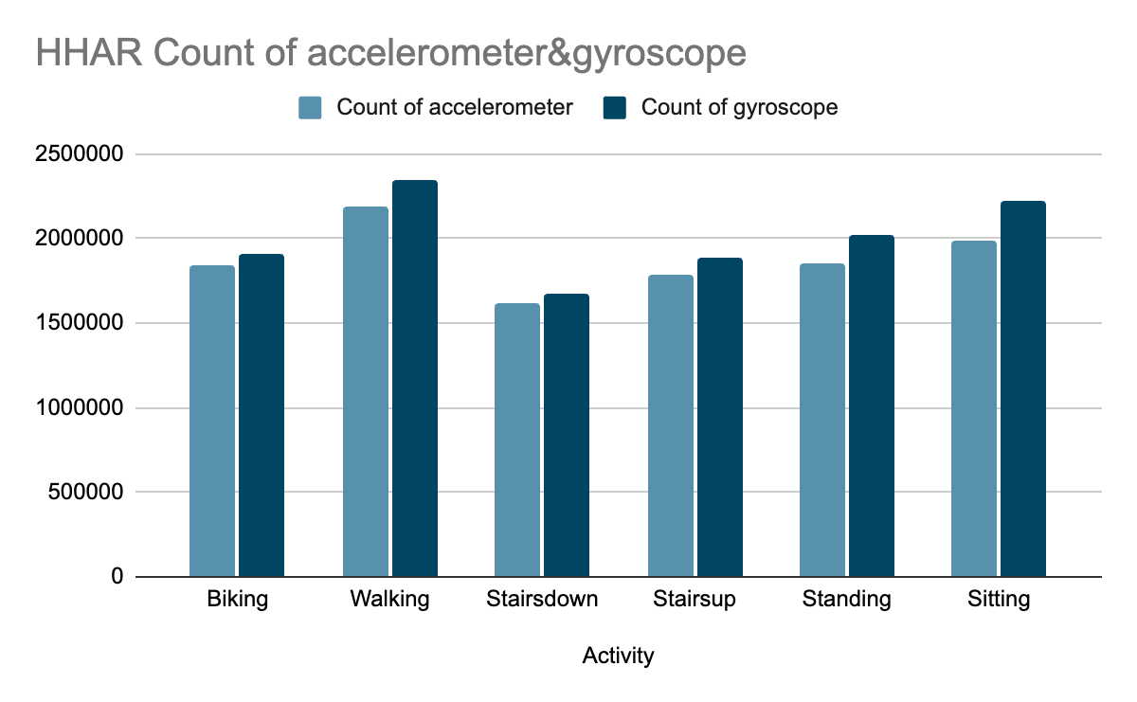
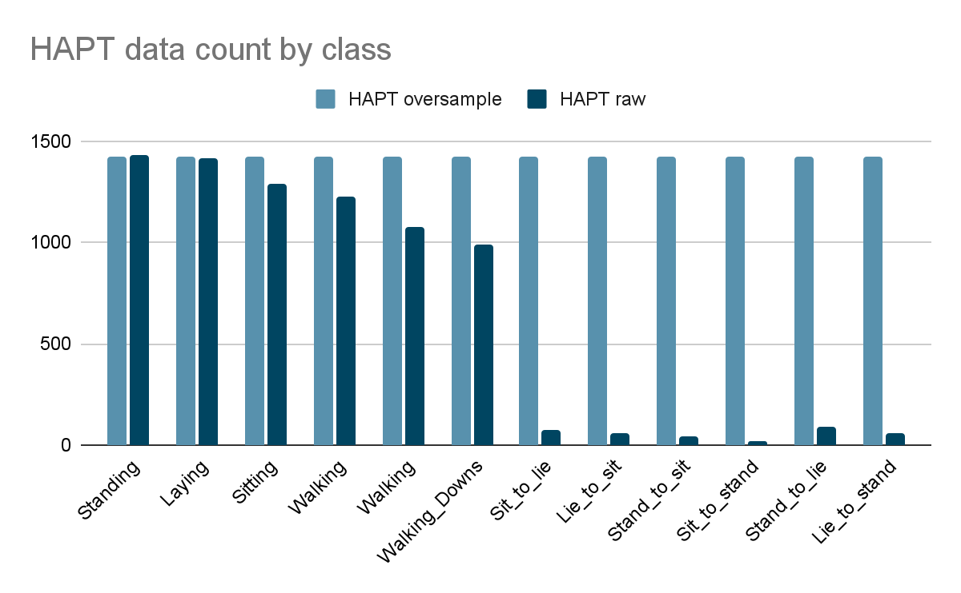
Dataset and imbalanced issue
UCIHAR
HHAR
HAPT
Time-series data
Upsampling?
Better solution?
Effectiveness of different sensors
Imbalanced classes and oversampling
liao0080@e.ntu.edu.sg

Slide 8
Experiment 1: Supervised model performance
Table 1-1 Supervised learning
Mean F1 Score% | ✔ CNN-LSTM Sup. | CNN-LSTM-ATT Sup. | Baseline
UCIHAR | 91.56 | 88.10 | 91.55
HHAR | 92.05 | 66.63 | 86.50
HAPT_replication | 83.81 | 80.37 | -
Take away:
CNN-LSTM model performs better than the CNN-LSTM-Attention model. CNN-LSTM model already captured the most relevant features with one-dimensional data, making the addition of an attention mechanism unnecessary.
FT. refers to fine-tuning performance, Sup. stands for supervised learning performance
liao0080@e.ntu.edu.sg

Slide 9
Experiment 1: SSL model performance
Table 1-2 Self-supervised learning
Mean F1 Score% | ✔ 5% FT. | 10% FT. | 100% Sup.(CNN-LSTM)
UCIHAR | 91.73 | 93.02 | 91.50
HHAR | - | 96.38 | 92.40
HAPT_raw | 85.16 | 86.38 | 84.79
Baselines | UCI-Mean F1 Score%
TS-TCC(Eldele(2021)) | 90.38
Ours work | 89.83
CNN-SSL(Saeed (2019)) | 88.90
CNN-SSL(Sarkar(2020)) | 63.73
Take away:
Fine-tuning only 5% label data, 1-D CNN SSL performs better than CNN-LSTM fully-supervised network with full-label data training. Our work is ranked second best comparing with baselines.
FT. refers to fine-tuning performance, Sup. stands for supervised learning performance
liao0080@e.ntu.edu.sg

Slide 10
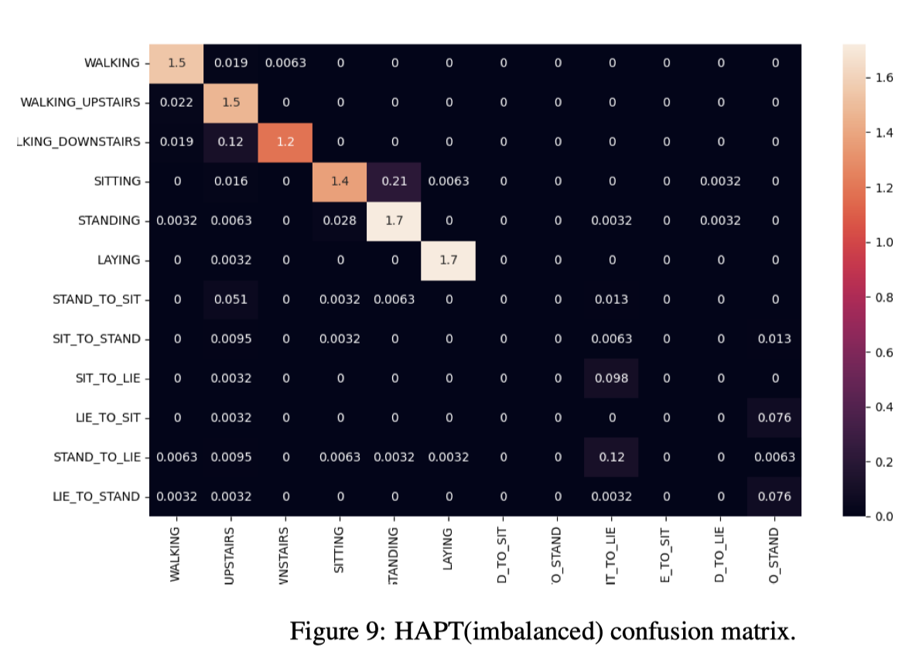
Experiment 2: HAPT Imbalanced data issue
Before
Table 2 Supervised learning
Oversample techniques recommandation
Mean F1 Score% | CNN-LSTM Sup. | CNN-LSTM-ATT Sup.
SMOTE(Synthetic Minority Oversampling Technique) | 84.84 | 93.38
✔Replication | 83.81 | 92.81
Take away:
0 f1 score in imbalance classes classification.
Use replication method: more computation cost saving, replicate data while train loader
liao0080@e.ntu.edu.sg

Slide 11
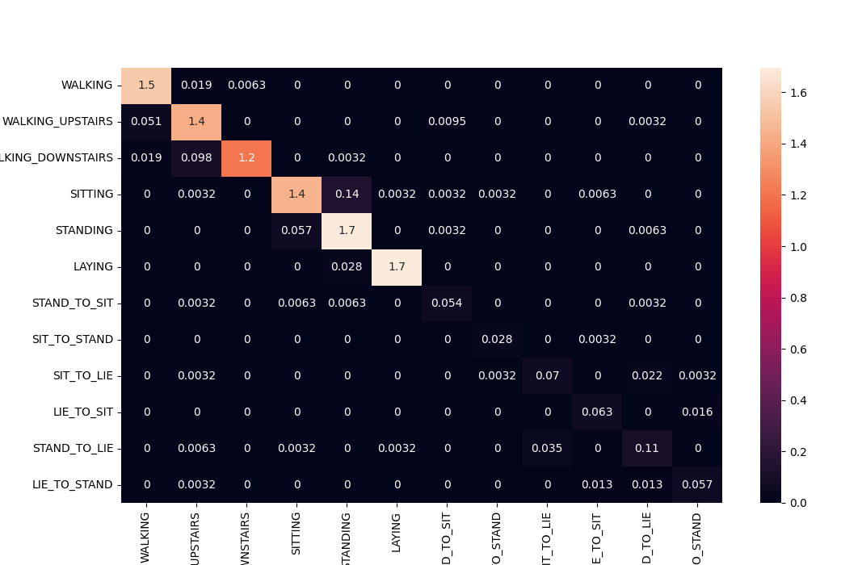
Experiment 2: HAPT Imbalanced data issue
Before
After
Take away:
After replication, the f1 scores improved, but still low. High computation needed to oversample.
Thus, we try SSL with imbalance raw data.
liao0080@e.ntu.edu.sg

Slide 12
Experiment 3: SSL robustness
Table 3-1 SSL ‘s robustness in HAPT imbalance classes
Data percentage | Data balance | STAND_TO_SIT | SIT_TO_STAND | SIT_TO_LIE | LIE_TO_SIT | STAND_TO_LIE | LIE_TO_STAND | F1-score%
5% FT. | ✔raw | 82.35 | 80 | 47.62 | 31.58 | 37.5 | 22.22 | 70.55
5% FT. | oversample | 69.57 | 75 | 40 | 13.33 | 43.75 | 24 | 70.01
100% Sup | raw | 0 | 0 | 9.8 | 0 | 0 | 7.6 | 51.74
Take away:
Proved SSL robustness in data imbalanced scenario. SSL can learn from the raw the data features instead of sample quantity.
liao0080@e.ntu.edu.sg

Slide 13
Experiment 4: HHAR Sensor effectiveness
Table 4
Mean F1 Score% | CNN-LSTM Sup. | CNN-LSTM-ATT Sup.
✔SP-accelerometer | 95.3 | 66.63
SP-gyroscope | 88.79 | 66.63
SW-accelerometer | 80.66 | 67.49
SW-gyroscope | 71.72 | 67.50
Take away:
smartphones with accelerometers are better suited for HAR classification.
SP stands for smartphone, SW stands for smartwatch.
liao0080@e.ntu.edu.sg

Slide 14
Future work
Expand study with image, graphic, audio and video data
Apply SSL with complex neural network
Transfer learning: extend current knowledge to different domain
1
2
3
liao0080@e.ntu.edu.sg

Slide 15

Q&A

Slide 16
Thank you.
liao0080@e.ntu.edu.sg

Slide 17
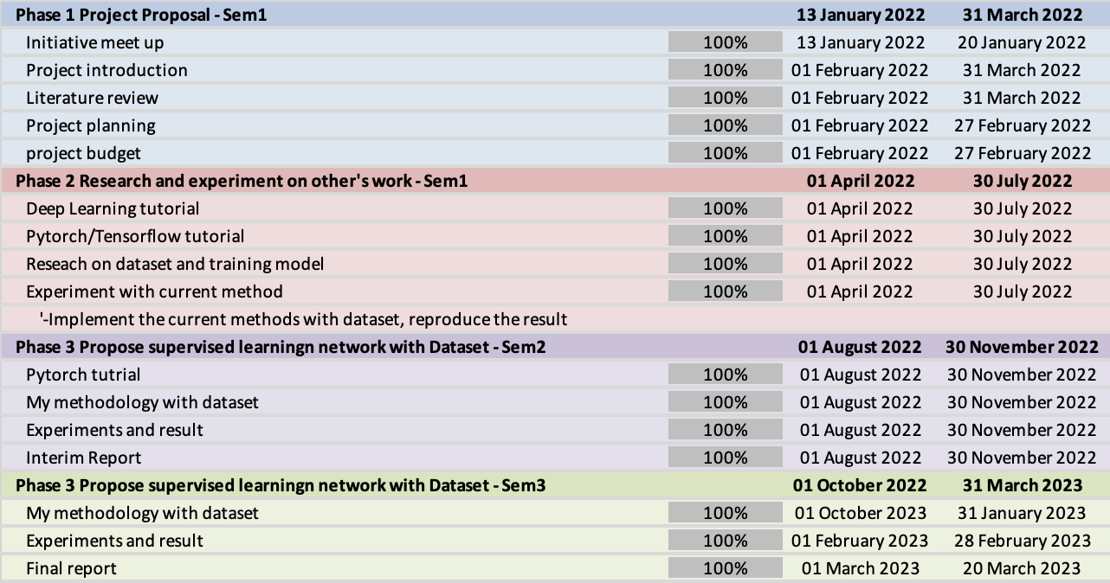
Apx: Project Planner

Slide 18
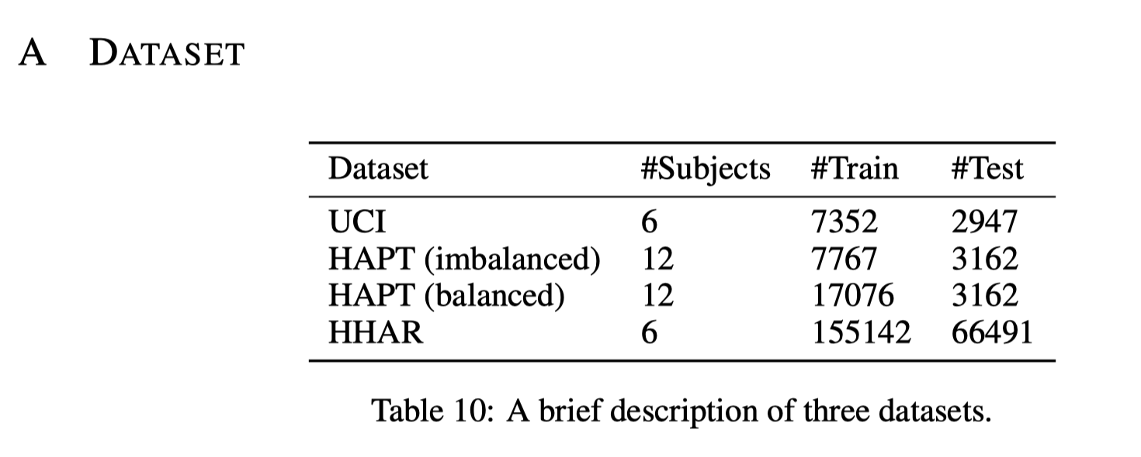
Apx: Datasets

Slide 19
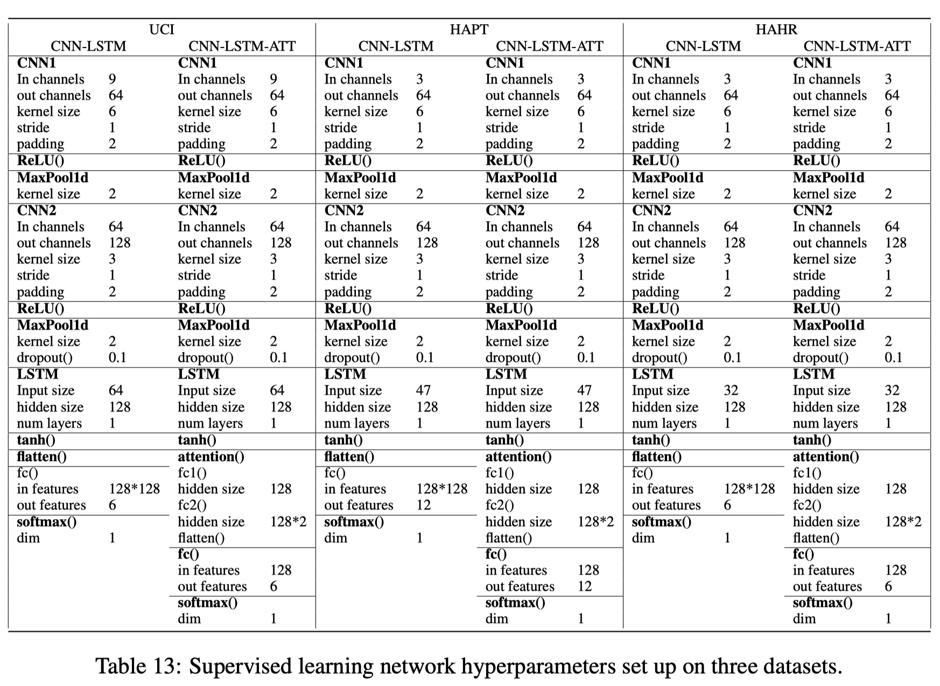
Apx: Network parameters-supervised

Slide 20
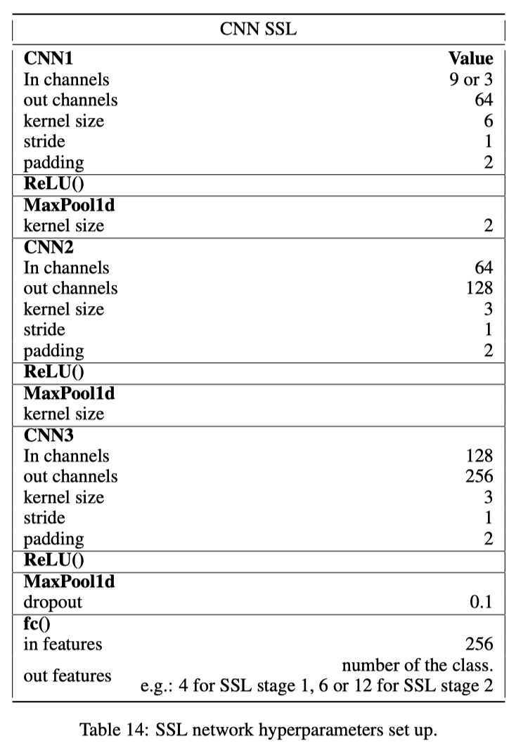
Apx: Network parameters-SSL

Slide 21
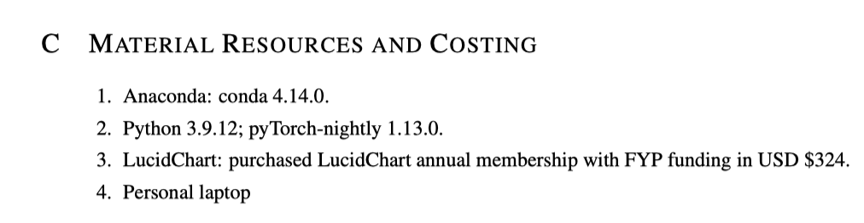
Apx: project material and costing

Slide 22
Experiment 3: SSL robustness
Table 3-1 SSL ‘s robustness in HAPT imbalance classes
Data percentage | Data balance | STAND_TO_SIT | SIT_TO_STAND | SIT_TO_LIE | LIE_TO_SIT | STAND_TO_LIE | LIE_TO_STAND | F1-score%
5% FT. | ✔raw | 82.35 | 80 | 47.62 | 31.58 | 37.5 | 22.22 | 70.55
5% FT. | oversample | 69.57 | 75 | 40 | 13.33 | 43.75 | 24 | 70.01
100% Sup | raw | 0 | 0 | 46.16 | 0 | 0 | 16.54 | 51.74
Table 3-2 SSL ‘s robustness with consistency loss
HHAR F1-Score(%) FT. | 1% | 5% | 10% | 50%
Criterion | 45.84% | 69.72% | 75.63% | 85.51%
✔MSE + Criterion | 46.05% | 70.08% | 76.77% | 85.72%
KLD + Criterion | 51.11% | 71.10% | 76.90% | 85.87%
liao0080@e.ntu.edu.sg
Notes:
We utilize the loss function to enhance network consistency by aggregating feature loss and incorporating it with classification cross-entropy loss on the 5% HAPT dataset. Specifically, we conduct experiments with both MSE and KLD functions and compare the results with the standard cross-entropy loss function.
//We investigate the effect of summing MSE loss or KLD loss to the criterion loss on SSL classification performance. The Table 5 results show that summing up MSE loss and criterion loss can improve the classification efficiency, but adding KLD loss did not have a positive impact. This is because of too many zeros in the input tensor, which did not contribute to the loss calculation. In order to enhance the robustness of the network, we opted to utilize the MSE loss function on the features. We applied the consistency loss to all the SSL experiments.

Slide 23
HELLO!
I am Liao ZiXin
I am here because I love to give presentations.
You can find me at liao0080@e.ntu.edu.sg

Slide 24
End

